Slide 1

Design Review 2
Team 3: Chandler Kuhn, Jack Sann, Bryan Hasselman, William Ho, Sam Coyle, Chris Sheehan
December 6, 2023
Notes:
Good afternoon everyone
Names

Slide 2
Outline
Project Objectives & Schedule
Mission Design
Sizing Inputs
Sizing Results
Aircraft Configuration
Anticipated Risks
Future Milestones
Summary
Notes:
The purpose of this design review is to document the initial project work, explain the basis for decisions, and elicit feedback and suggestions from the reviewers.

Slide 3
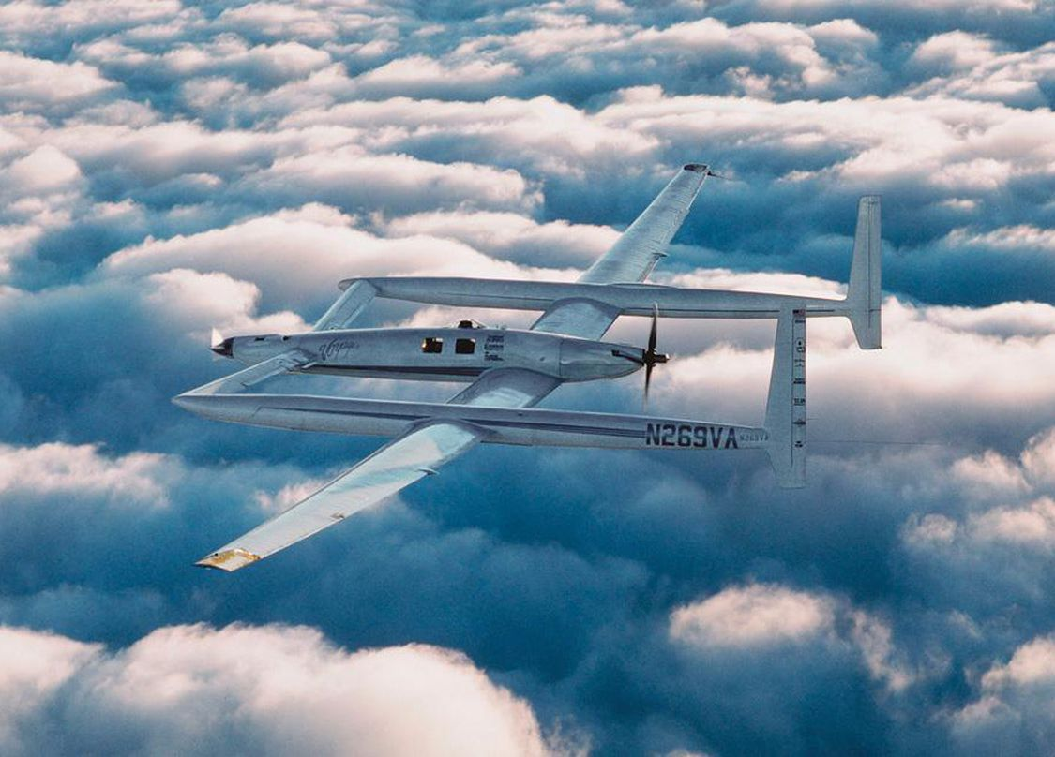
High-Level Objectives
Design an aircraft that can circumnavigate the world without refueling
Set record for fastest prop-driven airplane to circumnavigate, according to FAI guidelines
Honor the legacy of the Rutan Voyager
Notes:
High-level objectives of the project from when we were tasked with the project
Circumnavigate the world
Set FAI record for SPEED
Federation Aeronautique Internationale

Slide 4
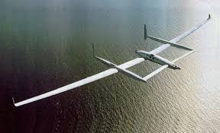
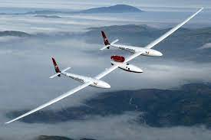
Competing Systems
Rutan Voyager (1986)
Record: Fastest propeller-driven aircraft around the world
Mission Range: 24,986 miles
Engine: Modified Continental O-200/240
Virgin Atlantic GlobalFlyer (2005)
Record: Fastest jet aircraft around the world record
Mission Range: 25,766 miles
Engine: Modified Williams International FJ44 turbofan
Source: National Air and Space

Slide 5

Mission Design
FAI Sporting Code Section 2, part 4.6.4: Speed Around the World, Nonstop and Non-refueled
Considerations
Record (FAI)
Safety
Profitability
Minimum Distance: 36,770km (19850 nm)
Pre-declared closed-circuit course
No landing or refueling
Cross all meridians
Lateral limits: +/- 66°
Record Speed = $\frac{\sum{\text{declared} \text{distance} \text{between} \text{control} \text{points}}}{\begin{aligned}\text{total} \text{flight} \text{time} \\ \end{aligned}}$
Notes:
Develop requirements for our program based off the needs of our stakeholders
Requirements explored in depth later in presentation
Internal:
Program Schedule
Logistics
External
Mission Profile
Support
End-User
Safety

Slide 6
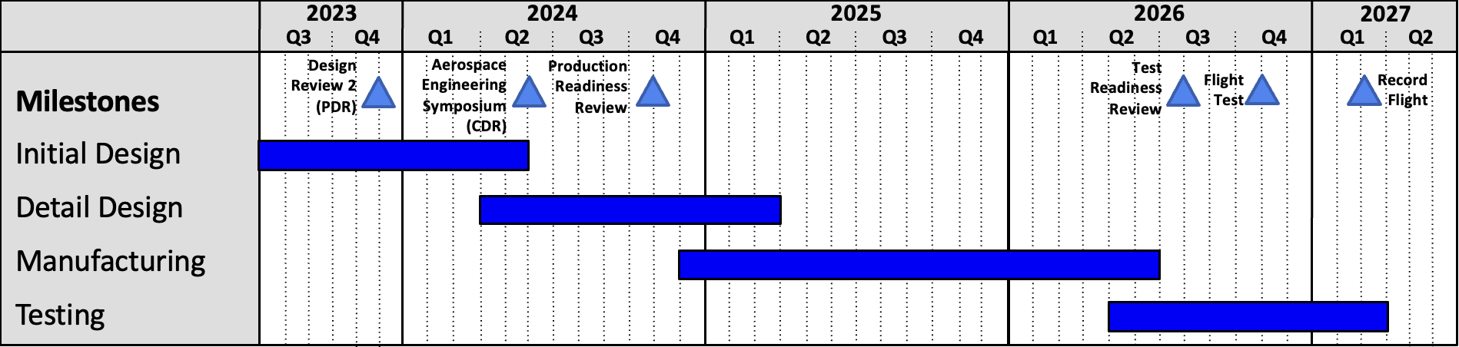
Program Schedule
Current Status: Initial Design
Complete: Mission Design, Sizing, Configuration
Upcoming: Subsystem Design
Notes:
Timeline of the overall program
From company management
Time: Ready to test by Jan. 2027
3 and a half year program
Design Complete: Jan. 2025
Manufacturing Complete: June 2026
18 months to manufacture

Slide 7
Flightpath Design
Atmosphere
Wind
Weather
Altitude
Terrain
Supplemental Oxygen
Safety
Available Diversion Runways
No-Fly Zones
Mission Parameters
Range: 20,650 nm
Cruise TAS: 110 knots
Considerations
Time: 170 hours
Dual Crew Weight: 300 lbs
Payload Weight: 300 lbs
Notes:
Mission Range: 38,250 km
Length of flightpath
Capable Range: 43,570 km​
Account for margin of safety
Mission Time: 180 hours​
Nominal mission time
Capable Flight Time: 205 hours
Maximum flight time of aircraft
Takeoff Distance: 12,000 feet
Runway distance is 14,000
Ground Speed: 115 knots​
Ground speed needed throughout flight
110 TAS, 10% faster than Voyager
Altitude: 8,000 feet​
(Assumption: average tail wind speed of 12 knots)

Slide 8
Mission Design
Takeoff & Landing Location: Edwards AFB, CA
Takeoff Distance: 14,000 ft
Average Cruise Altitude: 9,000 ft
Starting: 6,000 ft
End: 12,000 ft
Average Wind Speed: 17 knots
Cruise Ground Speed: 127 knots
Terrain avoidance
3. Cruise
-Increase altitude over time
2. Climb
4. Descent
1. Warm-up and Takeoff
5. Landing
Direction: East
Notes:
Mission Range: 20,560 nm
Length of flightpath
Capable Range: 23,500 nm​
Account for margin of safety
Mission Time: 180 hours​
Nominal mission time
Capable Flight Time: 205 hours
Maximum flight time of aircraft
Takeoff Distance: 12,000 feet
Runway distance is 14,000
Ground Speed: 115 knots​
Ground speed needed throughout flight
110 TAS, 10% faster than Voyager
Altitude: 6,000 – 12,000 ft
(Assumption: average tail wind speed of 17 knots)

Slide 9
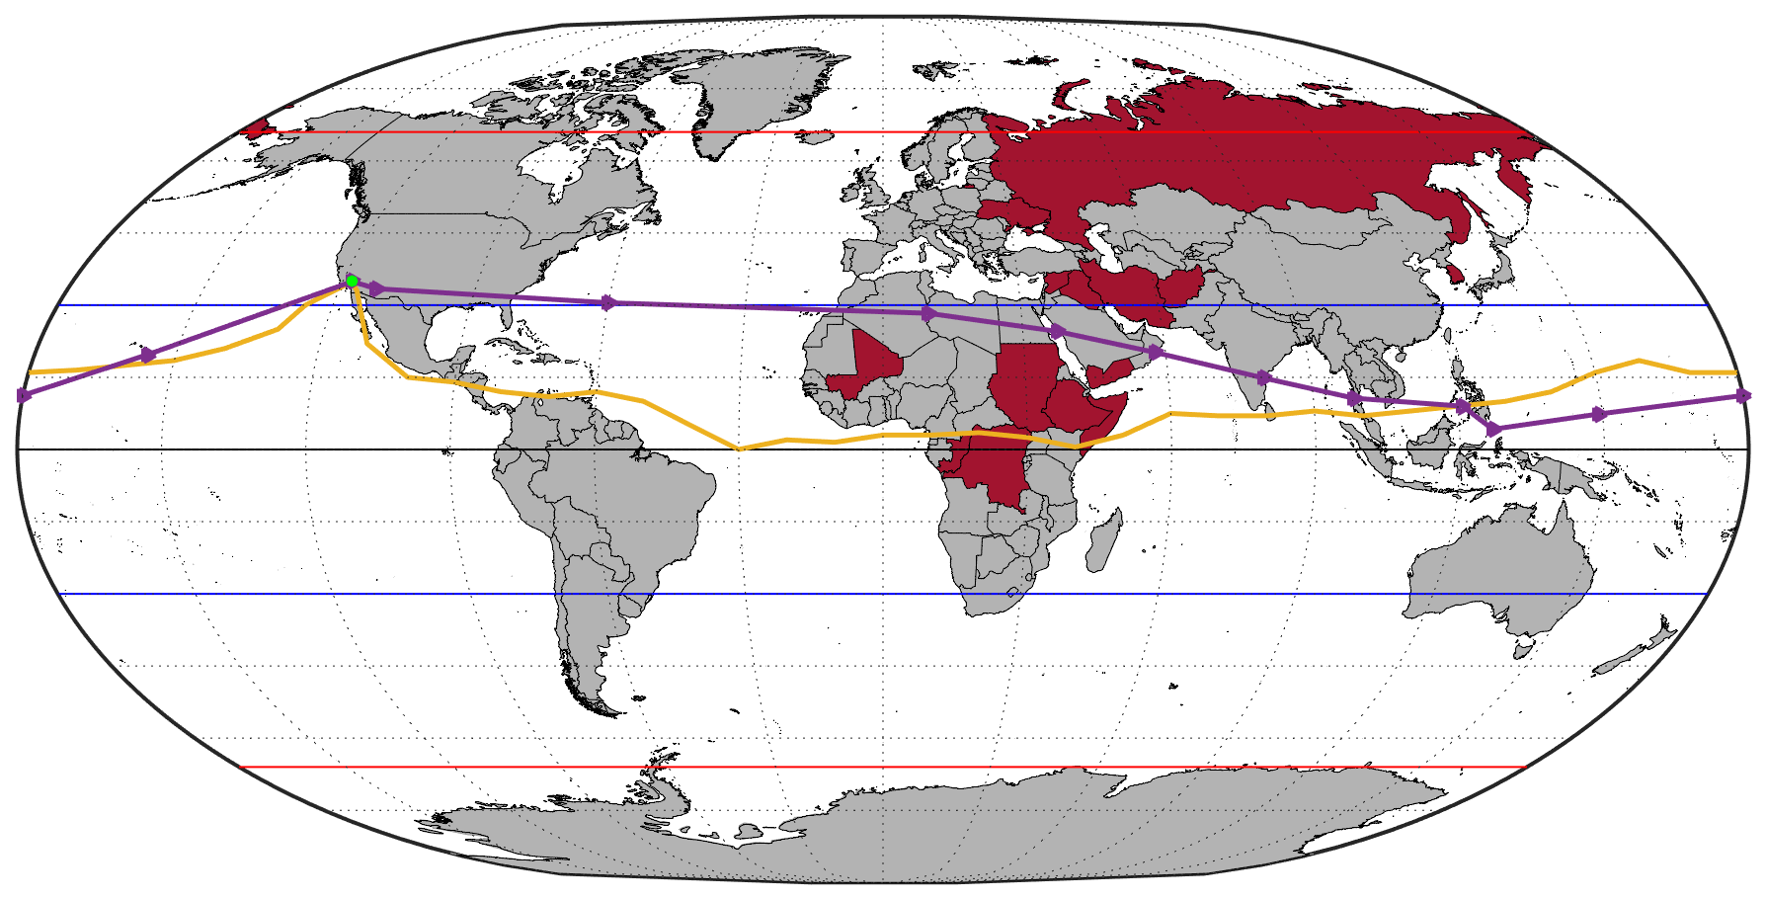
⟷ Mission flightpath
⟷ Voyager flightpath
● Edwards AFB
❖ No-fly zones
⟷ FAI Flight Limits
● Edwards AFB
⟷ FAI Flight Limits
⟷ Subtropic Belts
❖ No-fly zone
Mission Flightpath
66°
●
45°
30°
15°
0°
- 15°
- 30°
- 180°
- 150°
- 120°
- 90°
- 60°
- 30°
- 45°
0°
30°
60°
90°
120°
150°
180°
- 66°
Notes:
Mission Profile: 5 phases of flight with mission parameters
Conservative estimate of time, speed, altitude, distance for each phase
Takeoff and climb:
<12,000 feet of runway: runway is 14,000 feet, voyager took 14,000 feet
climb at relatively slower rate to conserve fuel
During daylight
Climb 2300 feet mountain in front of takeoff, 47 nautical miles 87 km away, With safety factor of 1000 feet
Cruise:
Slightly faster than the Rutan Voyager (100 knots)
Time: around 182 hours, roughly less than 8 days

Slide 10
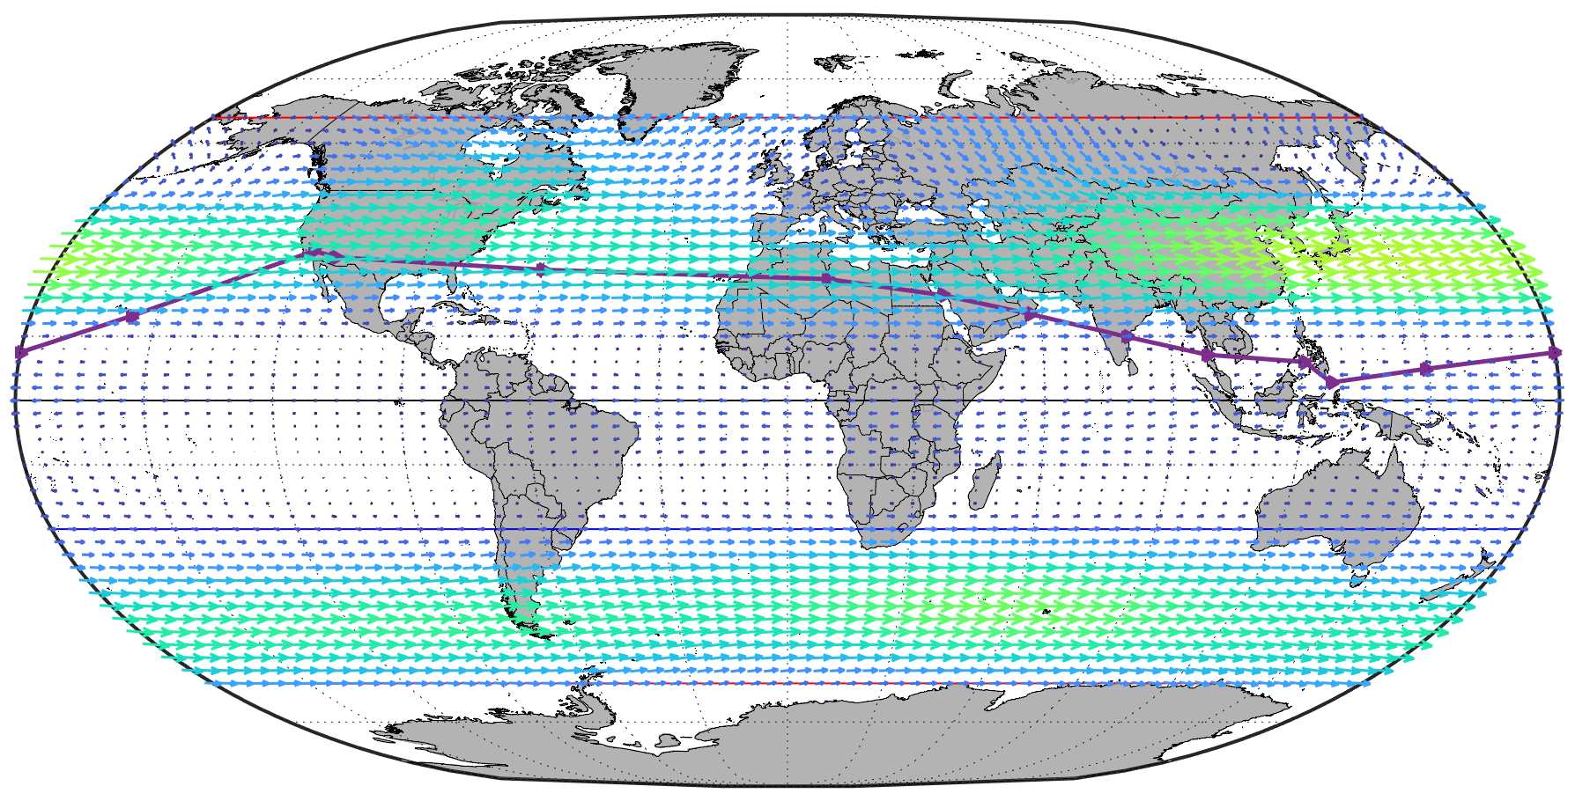
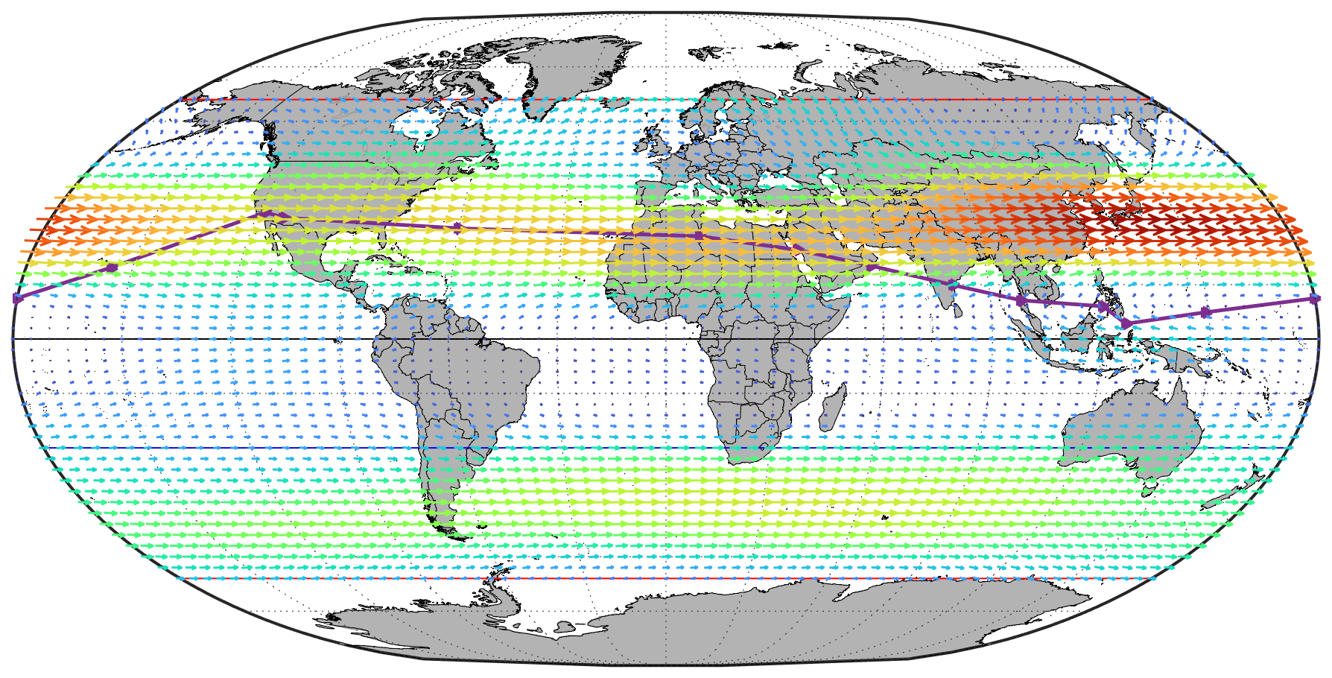
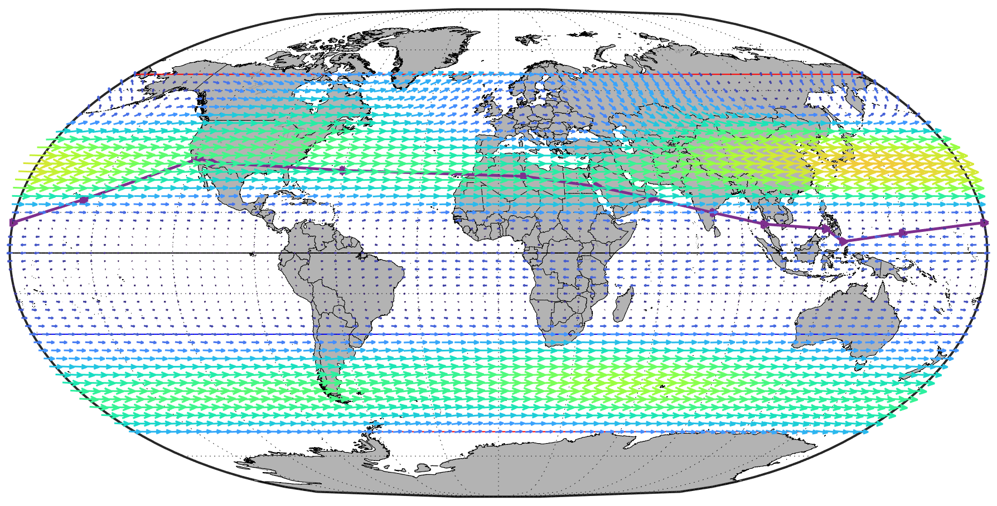
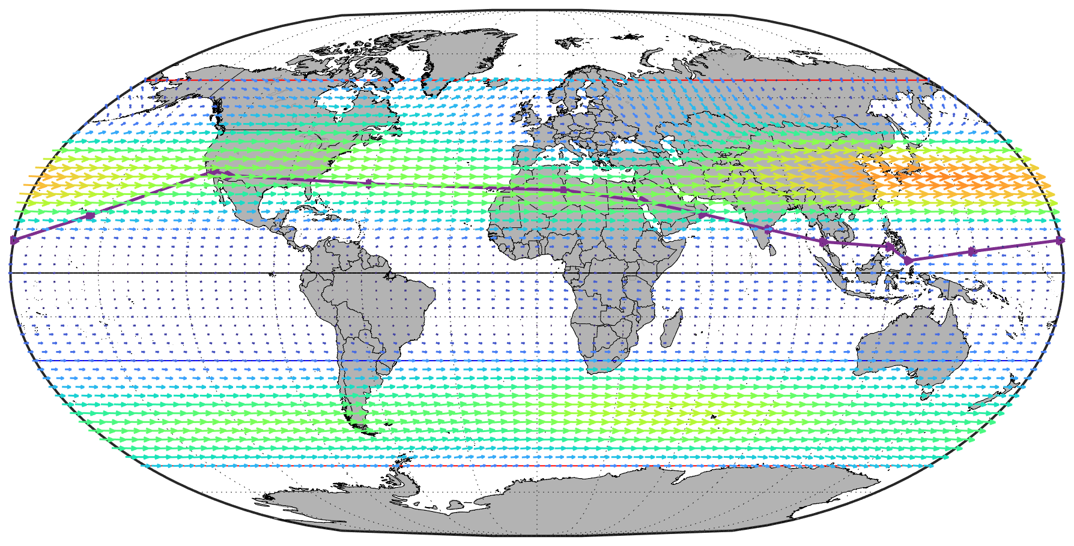
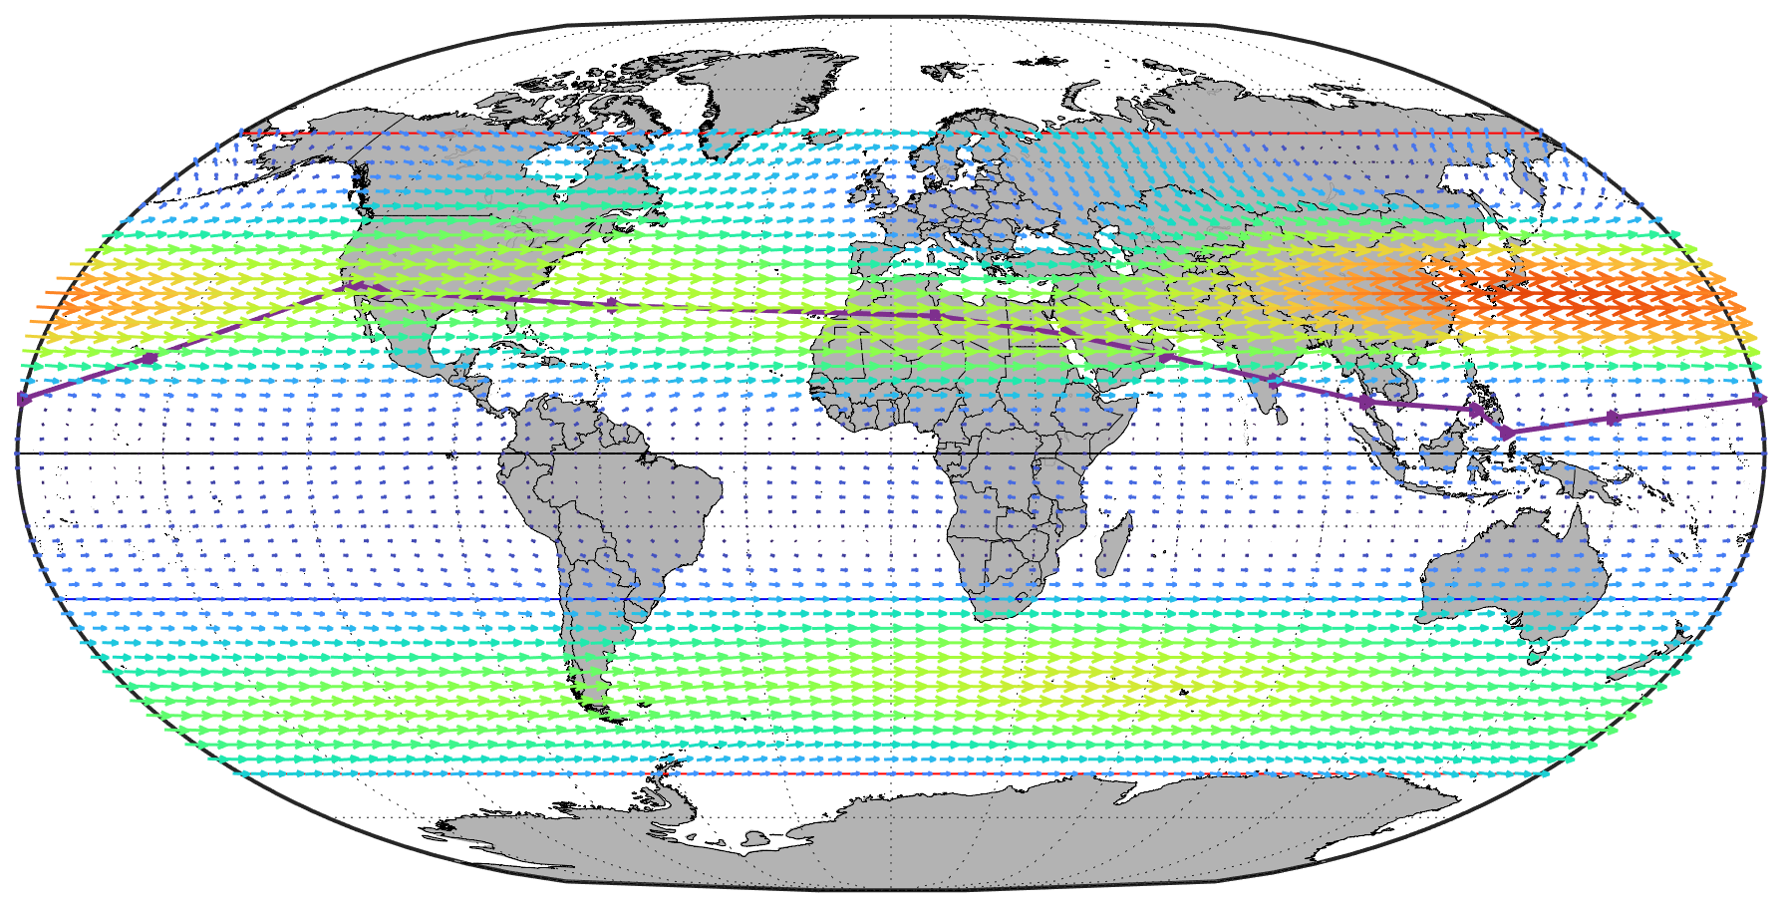

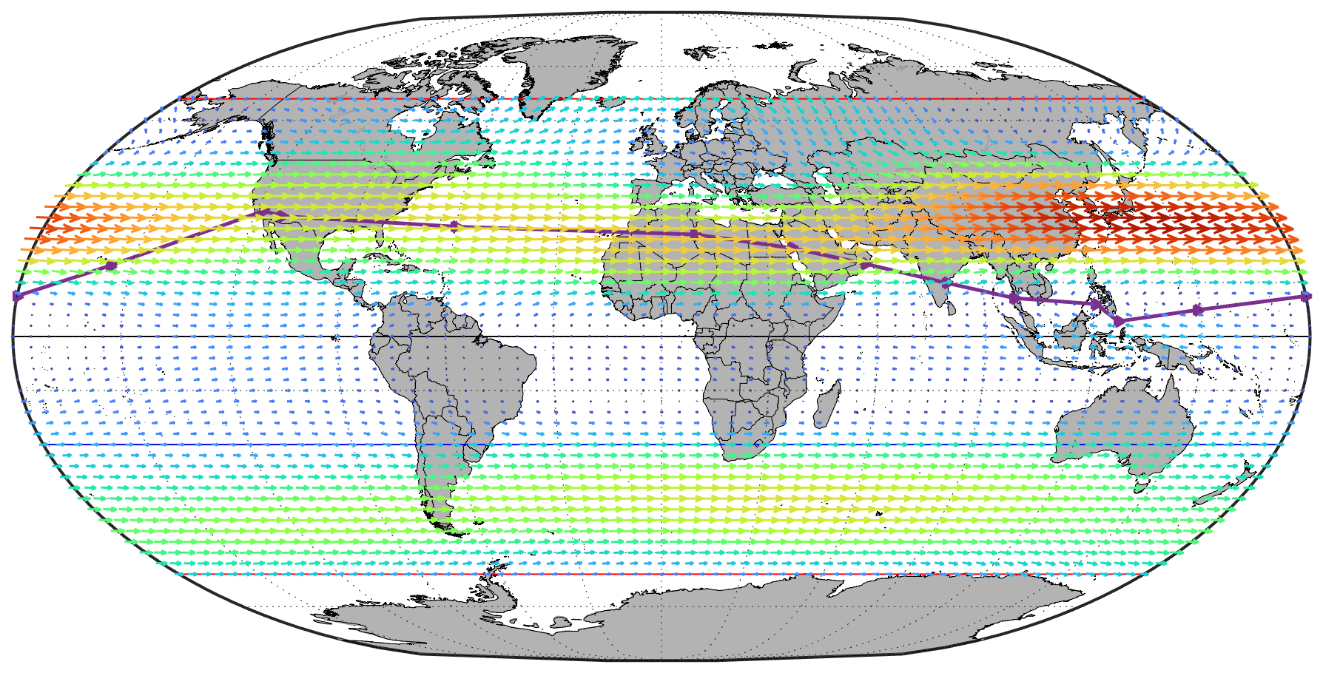


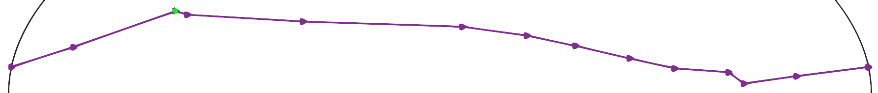
⟷ Mission flightpath
● Edwards AFB
⟷ FAI Flight Limits
⟷ Subtropic Belts
Average Wind Patterns
7000’
8000’
9000’
6000’
10000’
Altitude
55
12000’
11000’
50
66°
45
●
45°
30°
40
35
15°
30
0°
Wind Speed (knots)
25
- 15°
20
- 30°
15
- 180°
- 150°
- 120°
- 90°
- 60°
- 30°
- 45°
0°
30°
60°
90°
120°
150°
180°
10
- 66°
5
0
Notes:
8000 feet​
Would NOT require pressurization or oxygen​
Do not factor in specific monthly (February) winds​
​
Convective Atmospheric Potential Energy​
Stronger north and south of the high pressure belts​
Source: MATLAB
They used U.S. Naval Research Laboratory Horizontal Wind Model (HWM™) to calculate the meridional and zonal components of the wind

Slide 11
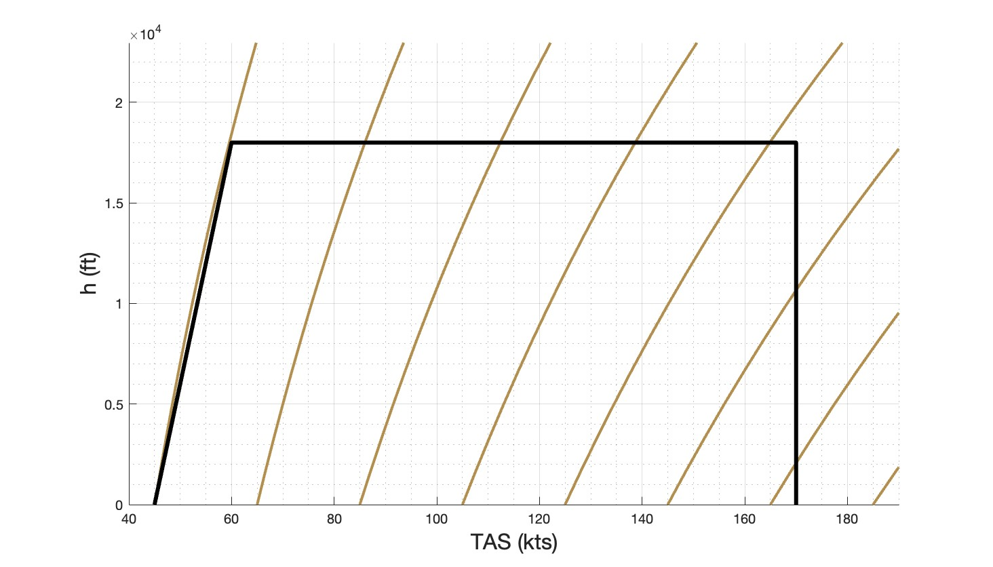
20,000
Absolute Ceiling: 18,000 ft
15,000
Altitude (ft)
10,000
5,000
CAS = 45
CAS = 65
CAS = 85
CAS = 105
CAS = 125
CAS = 145
CAS = 165
60
100
140
180
True Air Speed (kts)
Notes:
So this is the flight env that we will be designing to. You can see here our initial cruise condition at 6000 ft 110kts, and our final at 12000ft 100kts. In case we need to climb over any rough weather our abs celling is set at 18000ft as that is the standard limit or most internal combustion engines. Now if we are at that limit we most likely wont be able to reach our maximum speed of 170 kts, that’s ok, this limit was set based on a dive speed and will be updated as we select an engine.

Slide 12
L/D = 35
L/D = 25
L/D = 15
L/D = 5
Notes:
This graph shows the empty weight fraction vs range for various aircraft . The lines of constant L/D show how far an aircraft would go with that L/D at a given empty weight fraction. Immediately we can see that if we want to achieve our range an have an achievable L/D we need to be in this range here. Some things to note is that our design target is on roughly the same L/D curve as the rutan voyager hoever the empty weigh fraction is higher. We are able to set this more conservative empty weight fraction with the same L/D because we are planning on traveling less distance while still breaking the record.

Slide 13
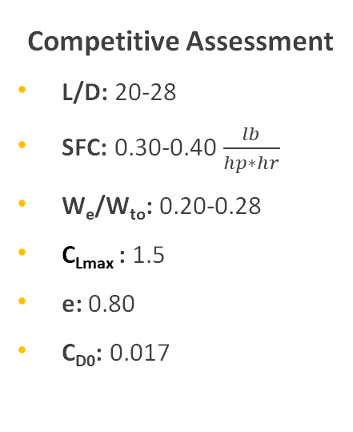
Initial Sizing Inputs
Competitive Assessment
L/D: 20-28
SFC: 0.30-0.40 $\frac{lb}{hp∗hr}$
W_{e}/W_{to}: 0.20-0.28
C_{Lmax} : 1.5
e: 0.80
C_{D0}: 0.017
Mission Design
Range: 20650 nmi
Payload Weight: 600 lbs
Altitude: 9,000 ft
Cruise: 110 KTAS

Slide 14
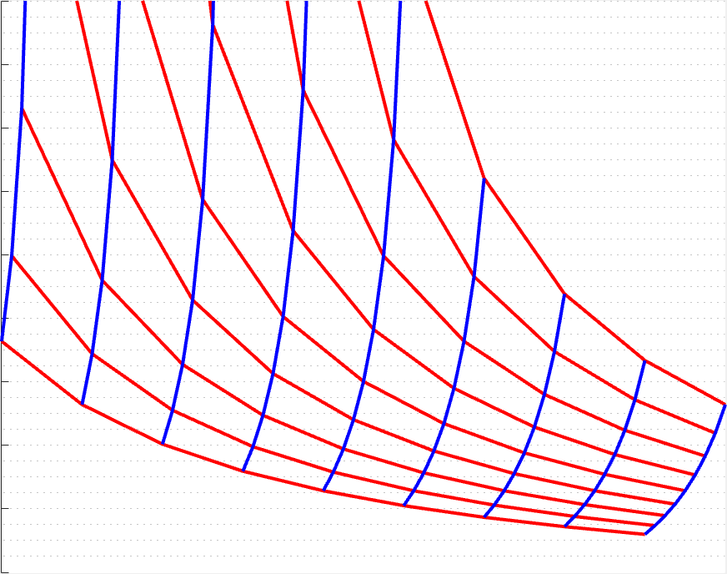
20,000
L/D = 20
L/D = 24
18,000
L/D = 22
SFC = .400
16,000
SFC = .375
14,000
SFC = .350
L/D = 26
12,000
MTOW (lbs)
10,000
SFC = .325
L/D = 28
SFC = .300
8,000
6,000
4,000
2,000
Mission Range = 20650 nmi, Payload Weight = 600 lbs, EWF = 0.24

Slide 15
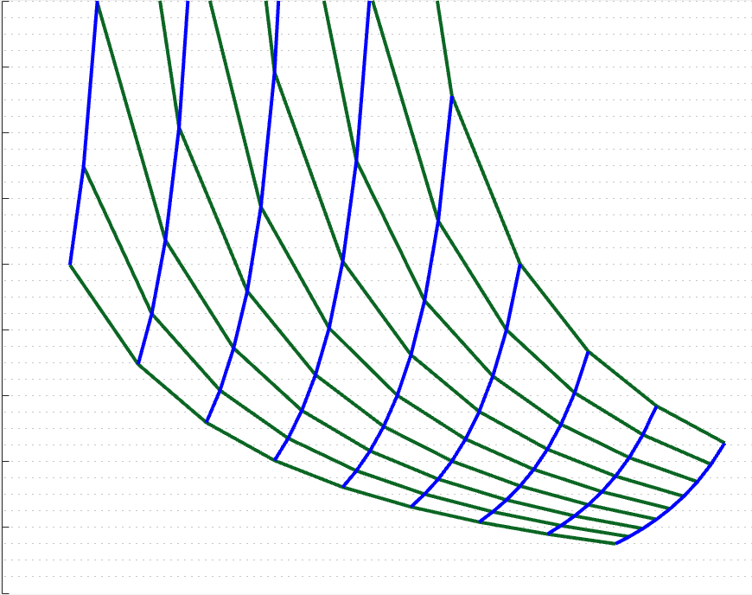
20,000
18,000
EWF = .22
EWF = .24
EWF = .26
EWF = .28
16,000
14,000
12,000
MTOW (lbs)
L/D = 20
EWF = .20
10,000
8,000
6,000
L/D = 22
4,000
L/D = 24
L/D = 26
L/D = 28
2,000
Mission Range = 20650 nmi, Payload Weight = 600 lbs, SFC = .350

Slide 16
Lift Analysis
Inputs
Cruise Speed: 110 KTAS
Avg. Weight: 6,200 lbs
L/D: 23
Outputs
C_{L}
W/S
AR
C_{D0}
Mission Design
Competitive Assessment
Configuration
Notes:
Estimates of Empty Weight Ratio
Main part of briefing
Group Weight Calculations
Started, covered at end of briefing
started calcs on empty weight
Build-Up Weight Calculation
Input when plane subsystems are designed, input individual parts
Weighing of Actual Parts
Weight actual parts during detail design, manufacturing
Compare to estimates and calculations

Slide 17
40
38
AR = 40
CD0 = 0.017
36
AR = 36
CD0 = 0.019
34
CD0 = 0.021
AR = 32
CD0 = 0.023
32
CD0 = 0.025
Wing Loading (lbs/ft^2)
30
AR = 28
28
AR = 24
26
24
22
e = 0.8, VTAS = 110 knots, Average Mission Weight = 6,200 lbs

Slide 18
40
38
AR = 40
36
AR = 36
CD0 = 0.019
CD0 = 0.019
34
CD0 = 0.021
CD0 = 0.021
AR = 32
CD0 = 0.023
32
CD0 = 0.025
CD0 = 0.017
Wing Loading (lbs/ft^2)
30
AR = 28
28
AR = 24
26
24
22
e = 0.8, VTAS = 110 knots, Average Mission Weight = 6,200 lbs

Slide 19
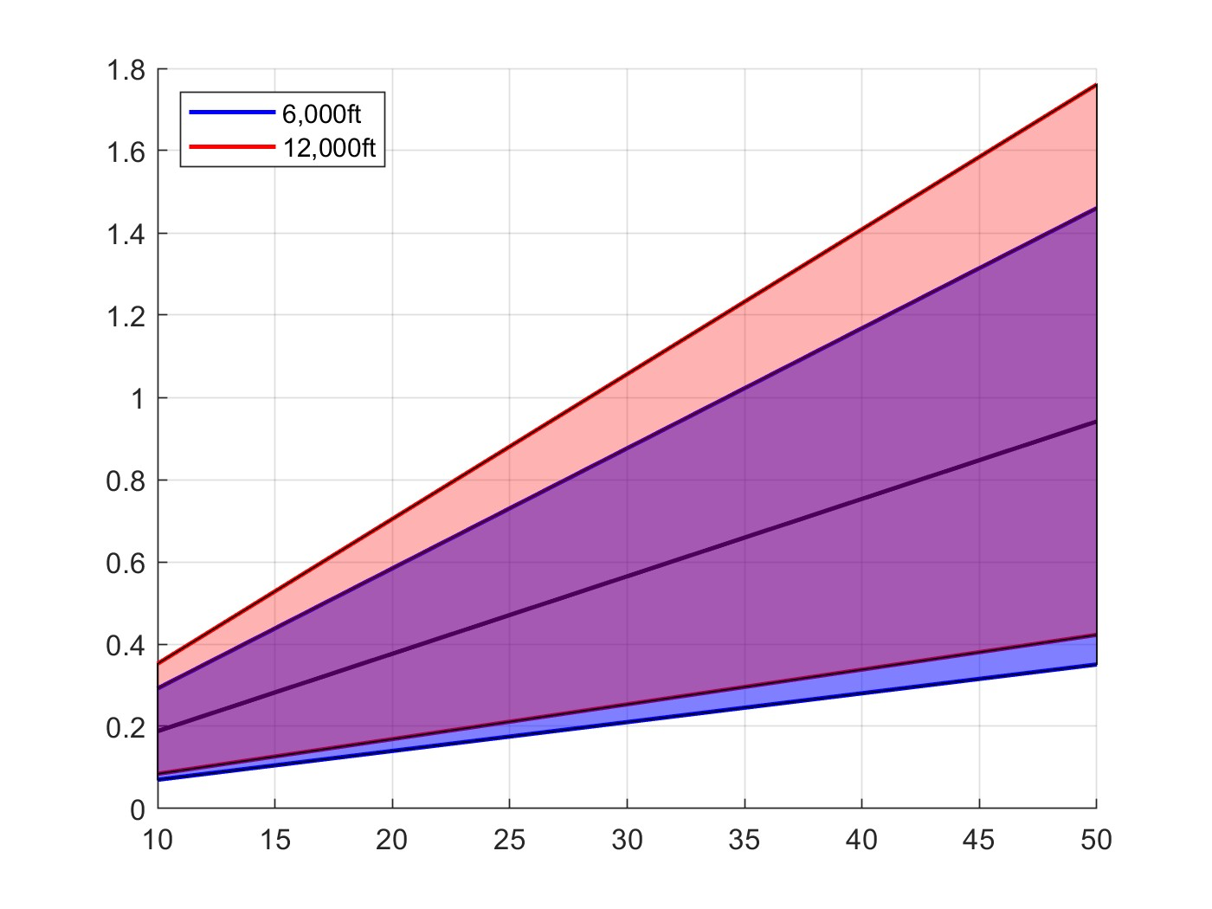
Lift Coefficient
Max-Weight Cruise
Average Cruise
Min-Weight Cruise
Wing Loading (lb/ft²)

Slide 20
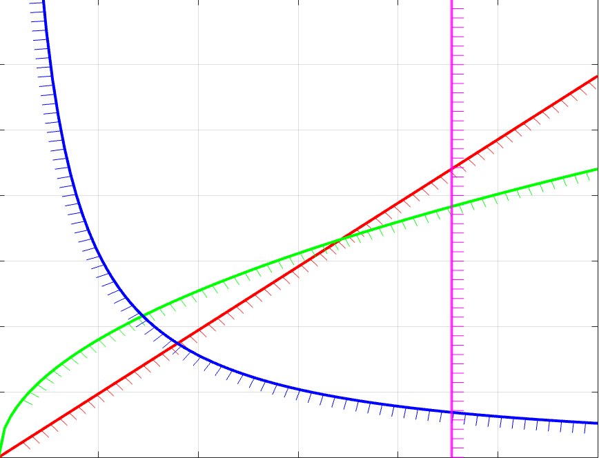


.07
Landing = 14,000 ft
W_{to} @Edwards AFB
.06
Takeoff = 14,000 ft
W_{to} @Edwards AFB
.05
Climb
@4% gradient
.04
P/W ($\frac{hp}{lbs}$)
.03
.02
Cruise
@6,000 feet, 110 knots
.01
10
20
30
40
50
L/D = 23, C_{Lmax} = 1.5, e = 0.8, C_{D0} = .017
W/S ($\frac{lbs}{{ft}^{2}}$)
Sam Coyle
20
Notes:
Using assumed aerodynamic coefficients, variables for relations based on requirements
Takeoff: < 14,000 feet
Takeoff from runway at EFB
Using takeoff parameter which is based on takeoff requirement from FAR 23
Cruise: at 8000 feet, 110 knots
Using power index, based on cruise speed
From mission design
Climb: > 4% climb gradient
According to CFR (code of federal regulations)
Requirement will be investigated further if necessary
Landing: < 14,000 feet
Worst Case Scenario: need to return to Edwards after failure upon takeoff
Other scenarios better since weight will be less

Slide 21
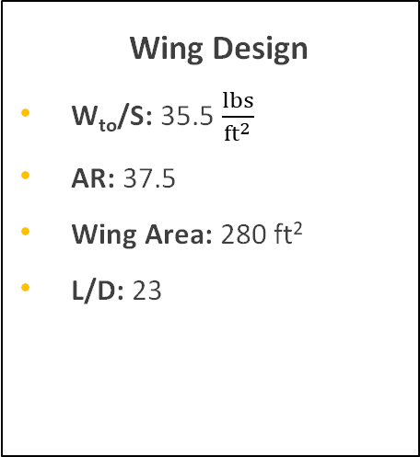
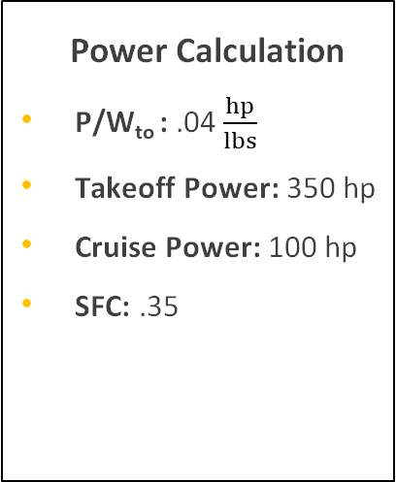
Sizing Results
Weight Calculation
W_{f}: 2400 lbs
W_{fuel}: 7000 lbs
W_{to}: 10000 lbs
EWF: .24
Wing Design
W_{to}/S: 35.5 $\frac{lbs}{{ft}^{2}}$
AR: 37.5
Wing Area: 280 ft²
L/D: 23
Power Calculation
P/W_{to} : .04 $\frac{hp}{lbs}$
Takeoff Power: 350 hp
Cruise Power: 100 hp
SFC: .35
Assumptions: e = 0.8, C_{D0} = .017, C_{Lmax}= 1.5

Slide 22
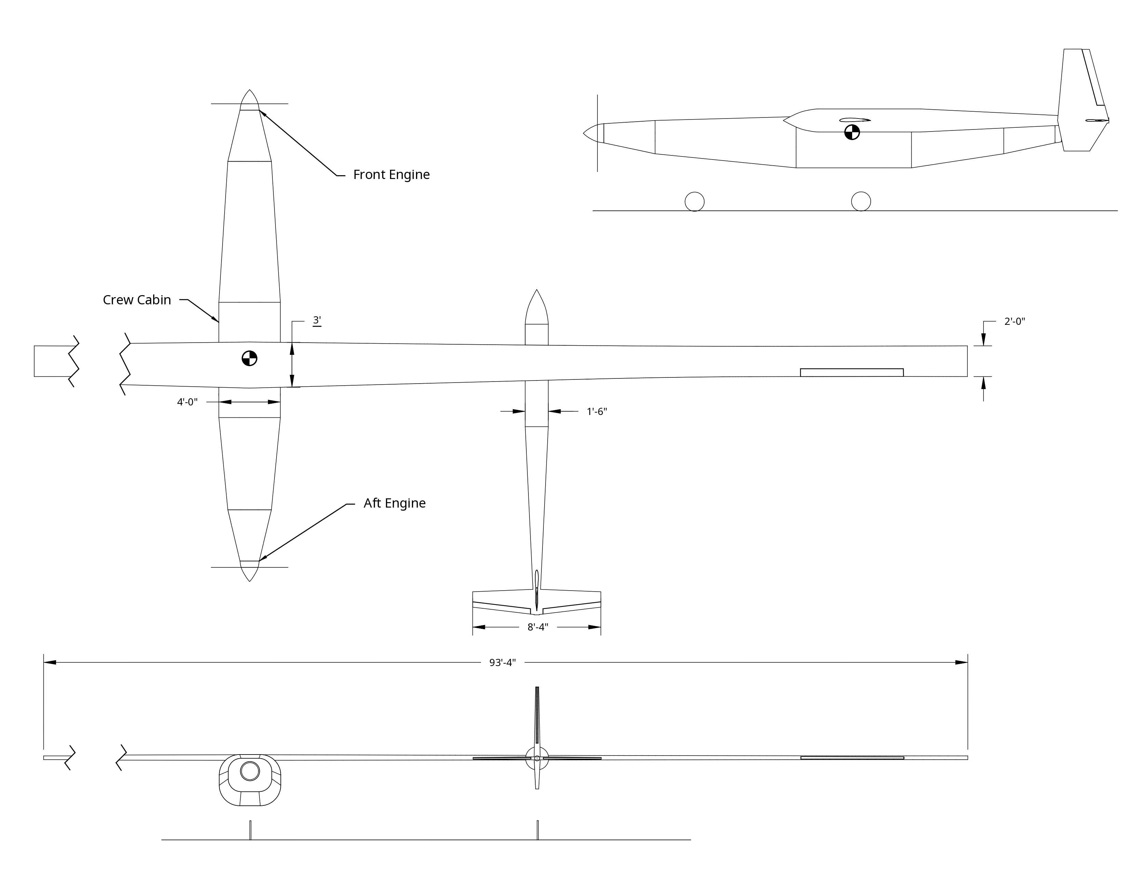


Slide 23
WING
FUEL
Aspect Ratio: 37.5 | W_{to}/S: 35.5 lbs/ft²
Root Chord: 36 in | Tip Chord: 24 in
Wingspan: 94 ft | Wing Area: 120 ft²
Total Fuel Volume | 7000 lbs, 1044 gal, 140 ft³
Wing Fuel Volume | 2200 lbs, 328 gal, 44 ft³
Fuselage Volume | 4800 lbs, 716 gal, 96 ft³

Slide 24
POWER
CABIN
Total Horsepower (Cruise/Takeoff) | 100/350 hp
Engine #1 | 130 hp
Engine #2 | 220 hp
Length | 7.5 feet
Width | 4.0 feet
Height | 3.8 feet

Slide 25
Preliminary Weight Statement
Item​ | Mass (lbs)​ | FS (in)​ | BL (in)​ | WL (in)​
Structure​ | ​-- | ​0.6 | ​0 | -0.25
Subsystems​ | ​-- | ​0.5 | ​0 | ​-0.4
Empty Weight​ | 2400.0​ | ​0.55 | ​0 | ​-0.325
Crew​ | 300.0​ | ​0.5 | ​0 | ​-0.65
Payload​ | 300.0​ | 0.4 | 0 | ​-0.75
Fuel​ | 7000.0​ | ​0.6 | ​0 | ​-0.25
Takeoff Weight​ | 10000.0​ | ​0.52 | 0 | ​-0.46
Future Steps:
Wing Design
Tail Design
Fuselage Design
Landing Gear Design
Subsystems Concept Design

Slide 26
Notes:
Complete: Competitive Assessment, Mission Design, Requirements
Used to create sizing inputs
Upcoming: Sizing, Quad Chart, Three-View Drawing, Design Review #2
Use sizing inputs to work on final sizing results in two weeks

Slide 27
Program Schedule
Timeline: Record Flight February 2027
Design Complete: March 2025
Manufacturing Complete: June 2026
Notes:
Timeline of the overall program
From company management
Time: Ready to test by Jan. 2027
3 and a half year program
Design Complete: Jan. 2025
Manufacturing Complete: June 2026
18 months to manufacture

Slide 28
Program Risks
Technical
Engine: Ability to function for entirety of mission
Parasitic Drag Coefficient (C_{D0}): Accuracy of variable
Operational
Schedule: Ability to stay on track in the future
Weather: Unforeseen conditions
Notes:
Specific Implications, assumptions
Engine
Be specific about variables that are uncertain
More about assumptions that are difficult to justify as rational thus far as oppose to things that we need to study
Questions:
Be honest, upfront- don’t make up somthing
Idk, Say when we will know

Slide 29
Upcoming Milestones
Trade Studies
Objective: Compare design types and configurations for profiles
Approach:
Performance
Aerodynamics
Structure
Feasibility
Subsystem Design
Objective: Design profiles and determine impact on configuration
Profiles:
Wing
Tail
Fuselage
Landing Gear

Slide 30
Summary
Project and Mission Scope Overview
Sizing Approach & Inputs
Sizing Results & Design Sensitivities
Aircraft Configuration & Characteristics

Slide 31
Mission Design
Takeoff & Landing Location: Edwards AFB, CA
Takeoff Distance: 14,000 ft
Average Cruise Altitude: 9,000 ft
Starting: 6,000 ft
End: 12,000 ft
Average Wind Speed: 17 knots
Cruise Ground Speed: 127 knots
-Terrain avoidance
3. Cruise
-Climb
2. Climb
4. Descent
1. Warm-up and Takeoff
5. Landing
Direction: East
Notes:
Mission Range: 38,250 km
Length of flightpath
Capable Range: 43,570 km​
Account for margin of safety
Mission Time: 180 hours​
Nominal mission time
Capable Flight Time: 205 hours
Maximum flight time of aircraft
Takeoff Distance: 12,000 feet
Runway distance is 14,000
Ground Speed: 115 knots​
Ground speed needed throughout flight
110 TAS, 10% faster than Voyager
Altitude: 8,000 feet​
(Assumption: average tail wind speed of 12 knots)

Slide 32
Flightpath Design
Weather
Wind
Inclement Weather
Altitude
Terrain
Oxygen Levels
Safety
Available Runways
No-Fly Zones
Notes:
Mission Range: 38,250 km
Length of flightpath
Capable Range: 43,570 km​
Account for margin of safety
Mission Time: 180 hours​
Nominal mission time
Capable Flight Time: 205 hours
Maximum flight time of aircraft
Takeoff Distance: 12,000 feet
Runway distance is 14,000
Ground Speed: 115 knots​
Ground speed needed throughout flight
110 TAS, 10% faster than Voyager
Altitude: 8,000 feet​
(Assumption: average tail wind speed of 12 knots)

Slide 33
Mission Design
Requirements
Mission Range: 20,650 nm
Cruise TAS: 110 knots
Considerations
Mission Time: 170 hours
Dual Crew Weight: 300 lbs
Payload Weight: 300 lbs
Item | Rationale | Weight (lbs)
Pilots & Parachutes |  | 300
Water |  | 112
Food |  | 48
Life Vest |  | 5
Emergency Raft |  | 15
Clothing |  | 30
Miscellaneous Items |  | 40
Oxygen |  | 50
Total Payload Weight | -- | 600
Notes:
Mission Range: 38,250 km
Length of flightpath
Capable Range: 43,570 km​
Account for margin of safety
Mission Time: 180 hours​
Nominal mission time
Capable Flight Time: 205 hours
Maximum flight time of aircraft
Takeoff Distance: 12,000 feet
Runway distance is 14,000
Ground Speed: 115 knots​
Ground speed needed throughout flight
110 TAS, 10% faster than Voyager
Altitude: 8,000 feet​
(Assumption: average tail wind speed of 12 knots)

Slide 34
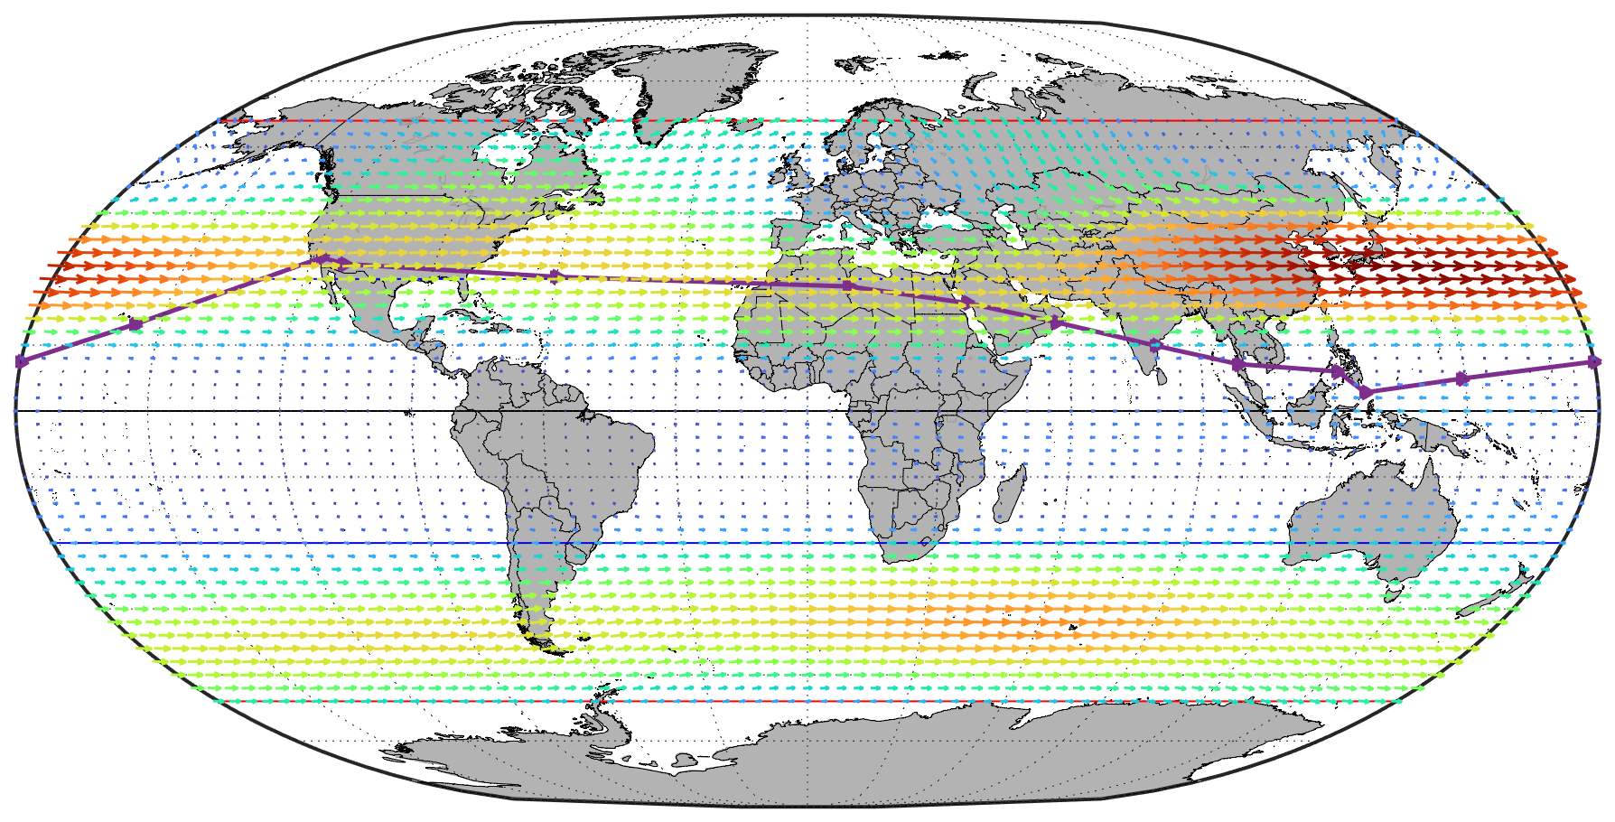
⟷ Mission flightpath
● Edwards AFB
⟷ FAI Flight Limits
⟷ Subtropic Belts
Average Wind Patterns
40
66°
35
●
45°
30°
30
15°
25
0°
Wind Speed (knots)
20
- 15°
- 30°
15
- 180°
- 150°
- 120°
- 90°
- 60°
- 30°
- 45°
0°
30°
60°
90°
120°
150°
180°
10
- 66°
5
0
Notes:
8000 feet​
Would NOT require pressurization or oxygen​
Do not factor in specific monthly (February) winds​
​
Convective Atmospheric Potential Energy​
Stronger north and south of the high pressure belts​
Source: MATLAB
They used U.S. Naval Research Laboratory Horizontal Wind Model (HWM™) to calculate the meridional and zonal components of the wind

Slide 35
⟷ Mission flightpath
● Edwards AFB
⟷ FAI Flight Limits
⟷ Subtropic Belts
Average Wind Patterns
40
66°
35
●
45°
30°
30
15°
25
0°
Wind Speed (knots)
20
- 15°
- 30°
15
⟷ Mission flightpath
- 45°
10
- 180°
- 150°
- 120°
- 90°
- 60°
- 30°
0°
30°
60°
90°
120°
150°
180°
- 66°
5
0
Notes:
8000 feet​
Would NOT require pressurization or oxygen​
Do not factor in specific monthly (February) winds​
​
Convective Atmospheric Potential Energy​
Stronger north and south of the high pressure belts​
Source: MATLAB
They used U.S. Naval Research Laboratory Horizontal Wind Model (HWM™) to calculate the meridional and zonal components of the wind

Slide 37
Altitude: 9,000 feet
Wind Patterns
Month: February
40
66°
35
●
45°
30°
30
15°
25
0°
Wind Speed (knots)
20
- 15°
- 30°
15
- 180°
- 150°
- 120°
- 90°
- 60°
- 30°
- 45°
0°
30°
60°
90°
120°
150°
180°
10
- 66°
5
0
Notes:
8000 feet​
Would NOT require pressurization or oxygen​
Do not factor in specific monthly (February) winds​
​
Convective Atmospheric Potential Energy​
Stronger north and south of the high pressure belts​
Source: MATLAB
They used U.S. Naval Research Laboratory Horizontal Wind Model (HWM™) to calculate the meridional and zonal components of the wind

Slide 38
Program Risks
Specific Implications, assumptions
Engine
Be specific about variables that are uncertain
More about assumptions that are difficult to justify as rational thus far as oppose to things that we need to study
Questions:
Be honest, upfront- don’t make up somthing
Idk, Say when we will know
Business
Profitability:
Cost, Marketing
Schedule
Plan of Execution
Technical
Record & Mission Viability:
Accuracy of Assumed Variables
Subsystem Design
Performance & Aerodynamic Calcs
Operational
Pilot Safety:
Hazardous Conditions
Weather Modeling
Emergency Procedures

Slide 39
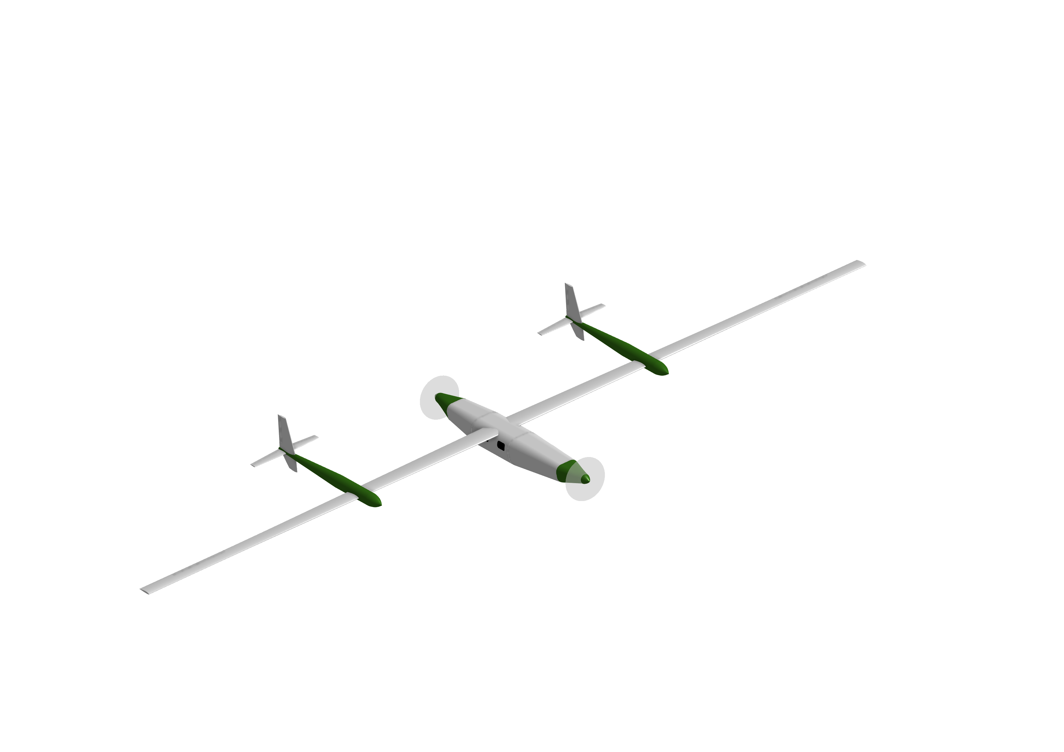
WING
FUEL
Aspect Ratio: 37.5 | W_{to}/S: 35.5 lbs/ft²
Root Chord: 36 in | Tip Chord: 24 in
Wingspan: 94 ft | Wing Area: 120 ft²
Total Fuel Volume | 8000 lbs, _ gal, _ ft³
Wing Fuel Volume | 8000 lbs, _ gal, _ ft³
Fuselage Volume | 8000 lbs, _ gal, _ ft³

Slide 40
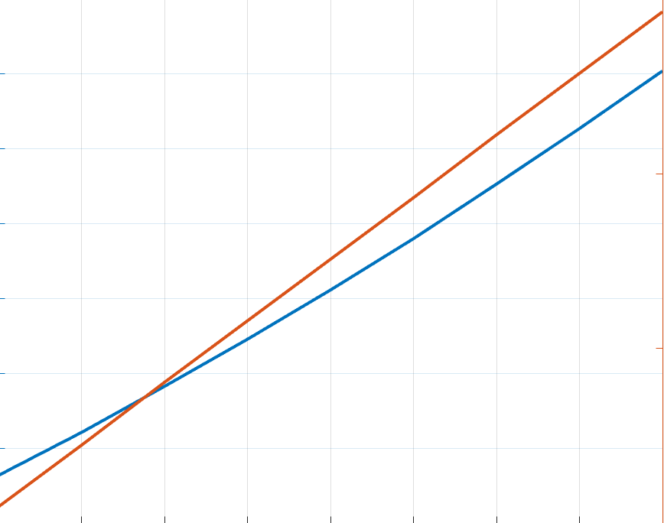

50
55
50
45
45
Aspect Ratio
Wing Loading ($\frac{lbs}{{ft}^{2}}$)
40
40
35
30
35
21
22
23
24
25
26
27
L/D
Cruise: 110 kts @ 8,000 feet, e = 0.8, C_{D0} = .017

Slide 41
Cruise Lift Coefficient = 0.78
Cruise Wing Loading = 35.58
Assumptions: L/Dmax = 23, e = 0.8, Cd0 = 0.017

Slide 42
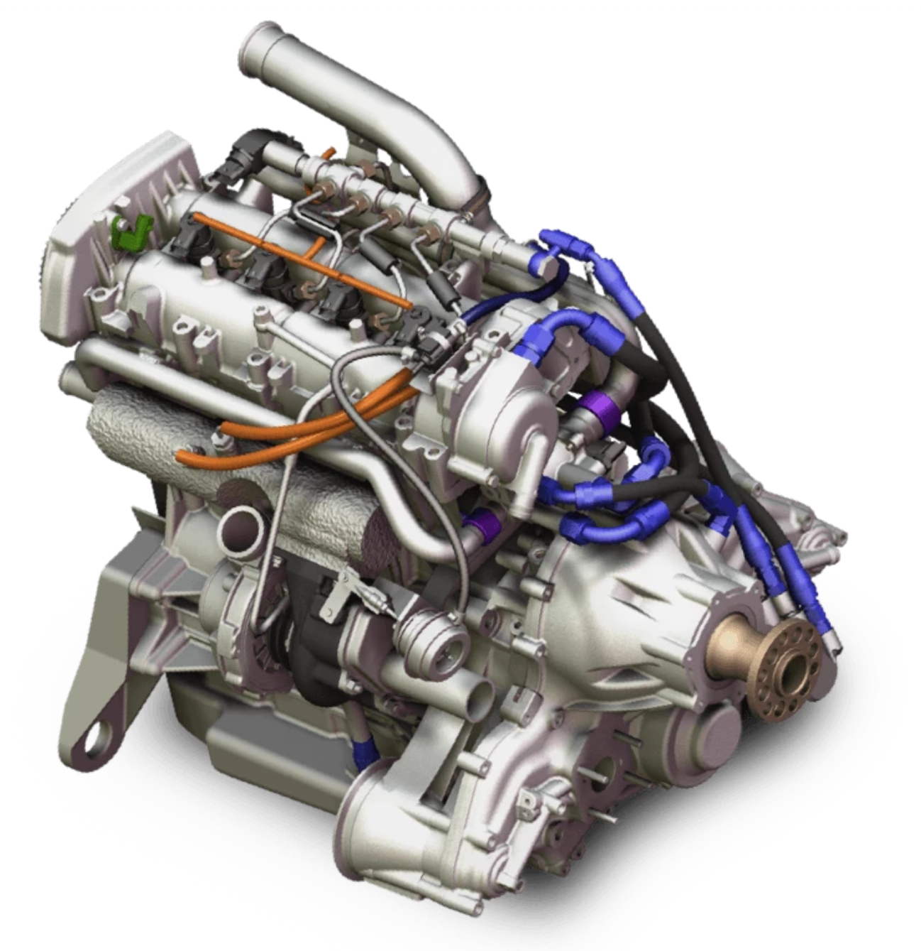
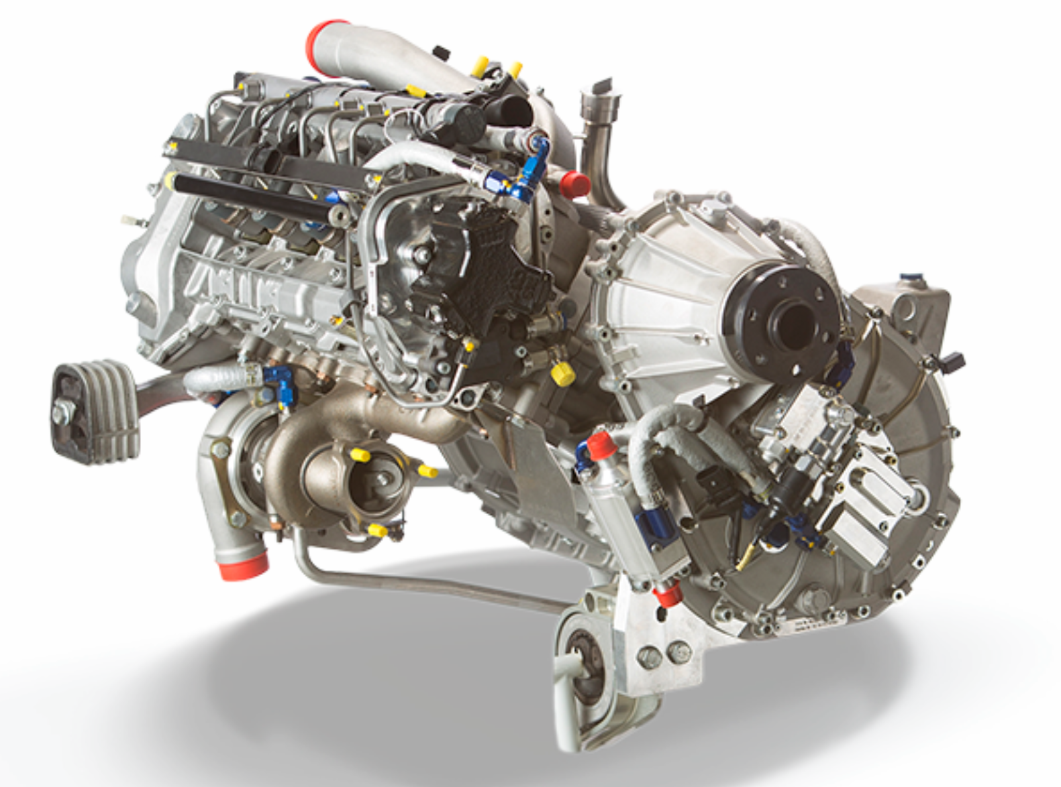
Powerplant Considerations
DEL-120
Dry Weight: 360 lbs
Rated Horsepower: 205 Hp
Cruise Horsepower (75% power): 180 Hp
PSFC: 0.345
CD-155
Dry Weight: 295.4 lbs
Rated Horsepower: 155 Hp
Performance Cruise (75% rated): 132 Hp
PSFC: 0.35
Source: Continental, Lycoming

Slide 43
Business
Major Expenses
Materials
Labor
Manufacturing
Test
Execution
Proposed Financers
Corporate and Industry Sponsors
Government and Research Sponsors
Philanthropic and Sustainability Organizations
Venture Capital & Private Equity
Notes:
Develop requirements for our program based off the needs of our stakeholders
Requirements explored in depth later in presentation
Internal:
Program Schedule
Logistics
External
Mission Profile
Support
End-User
Safety

Slide 44
Business
Operations
Proposed Financers
Corporate and Industry Sponsors
Government and Research Sponsors
Philanthropic and Sustainability Organizations
Venture Capital & Private Equity
Major Expenses
Materials
Labor
Manufacturing
Test
Execution
Mission
Cross all nav-points
Communicate Telemetry
Verify Flight Performance
Emergency Outcomes
Mid-Flight Emergency Landing
Return to Field
Water Ditching

Slide 45
Trade Studies

Slide 46
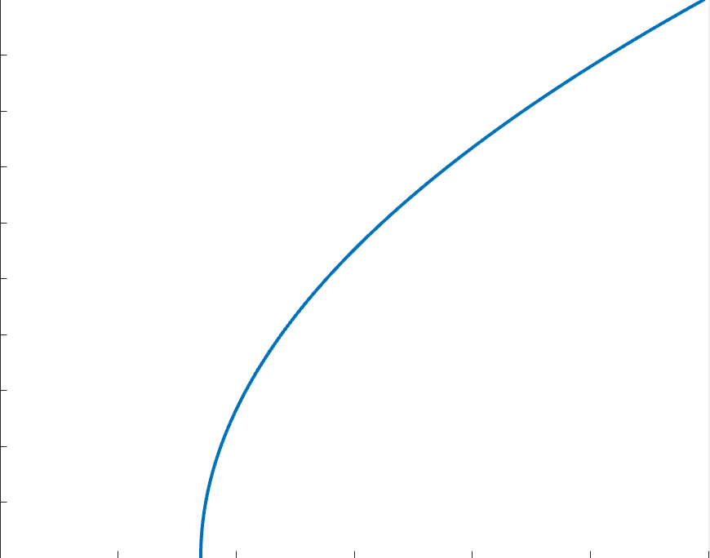
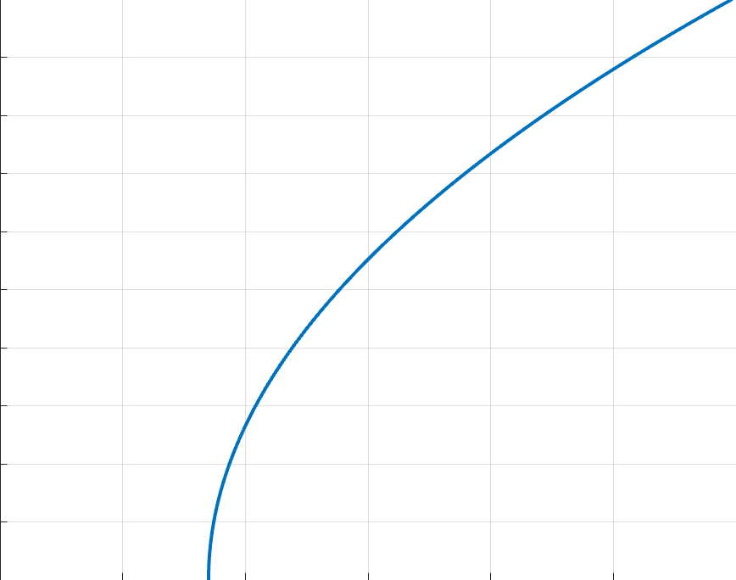
1.8
1.4
Takeoff Weight
Max L/D
C_{L}
1.0
.6
Empty Weight
.2
.01
.02
.03
.04
.05
C_{D}
e = 0.8, C_{D0} = .017, L/D_{max} = 23, AR = 37.5, W/S = 35.5 lbs/ft²

Slide 47
Program Approach
Program Needs
World Record
Safety
Profitability
Regulations
Business
Operations
Notes:
Develop requirements for our program based off the needs of our stakeholders
Requirements explored in depth later in presentation
Internal:
Program Schedule
Logistics
External
Mission Profile
Support
End-User
Safety

Slide 48
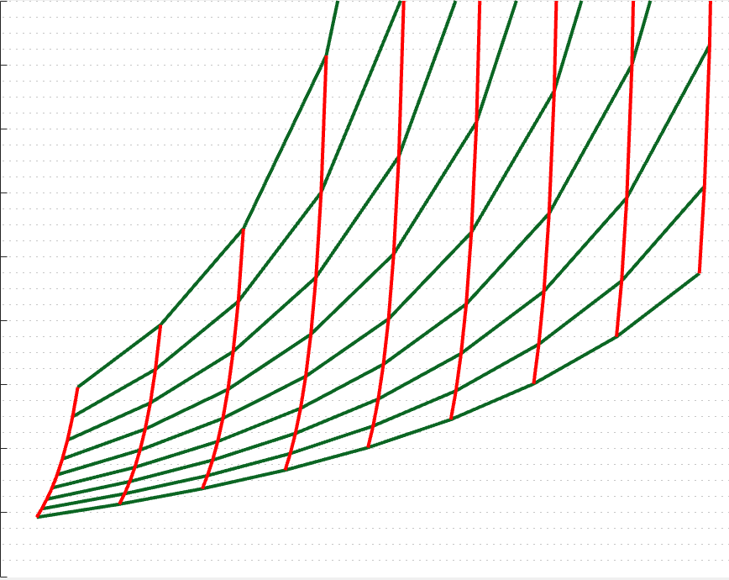
20,000
18,000
SFC = .375
SFC = .400
SFC = .350
EWF = .28
16,000
SFC = .325
EWF = ..24
14,000
EWF = ..26
EWF = .22
12,000
MTOW (lbs)
EWF = .20
10,000
SFC = .300
8,000
6,000
4,000
2,000
Mission Range = 20650 nmi, Payload Weight = 600 lbs, L/D = 23

Slide 49
Program Approach
Internal Stakeholders
Company Management
Engineering Team
External Stakeholders
FAA & other regulatory agencies
FAI
End-Users
Sponsors & Investors
Pilots
Internal Needs
Profitability
Logistics
Feasibility
External Needs
Mission Parameters
External Safety
Communication
End-User Needs
Marketing
Mission Success
Safety
Notes:
Develop requirements for our program based off the needs of our stakeholders
Requirements explored in depth later in presentation
Internal:
Program Schedule
Logistics
External
Mission Profile
Support
End-User
Safety

Slide 50
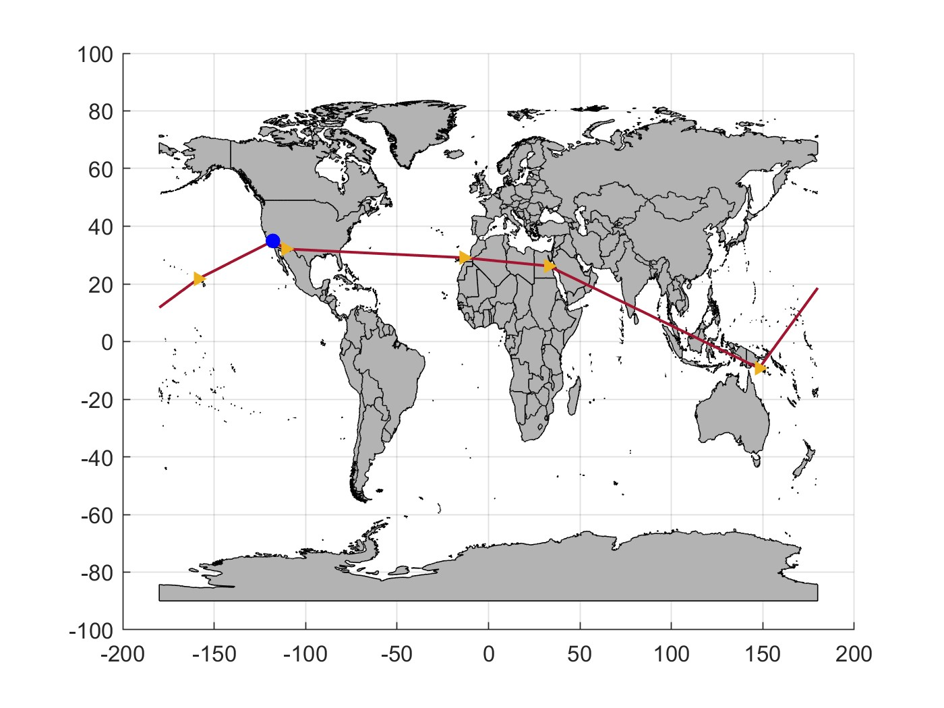


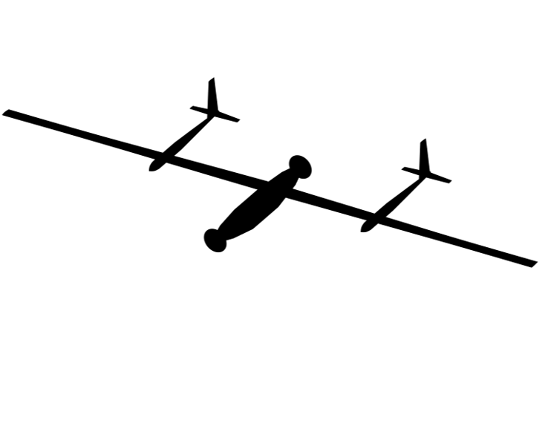


Concept of Operations
(3) Cruise
-front engine on
(2) Climb
- Both engines on
(4) Descent
(1) Takeoff & (5) Landing
Ground Support Station
Airport: Edwards AFB, CA
Notes:
Flightpath: Depicts 5 phases of flight
Takeoff and land at same airport
Support and Safety: Ground support communicates around the world via satellite, emergency support on standby

Slide 51
Mission
Cross all nav-points
Communicate Telemetry
Verify Flight Performance
Emergency Outcomes
Mid-Flight Emergency Landing
Return to Field
Water Ditching
Notes:
Develop requirements for our program based off the needs of our stakeholders
Requirements explored in depth later in presentation
Internal:
Program Schedule
Logistics
External
Mission Profile
Support
End-User
Safety

Slide 52
Program Sizing Process
Estimates of Sizing Inputs
Group Sizing Calculations
Build-Up Calculations
Testing of Actual Parts
Initial Design
Detail Design
Manufacturing
Notes:
Estimates of Empty Weight Ratio
Main part of briefing
Group Weight Calculations
Started, covered at end of briefing
started calcs on empty weight
Build-Up Weight Calculation
Input when plane subsystems are designed, input individual parts
Weighing of Actual Parts
Weight actual parts during detail design, manufacturing
Compare to estimates and calculations

Slide 53
CL, max Analysis
 | CL,max | CL,max Take-Off | CL, L
Twin engine propeller | 1.2 – 1.8 | 1.4 – 2.0 | 1.6 – 2.5
Regional turboprop | 1.5 – 1.9 | 1.7 – 2.1 | 1.9 – 3.3
Business jets | 1.4 – 1.8 | 1.6 – 2.2 | 1.6 – 2.6
Transport jets | 1.2 – 1.8 | 1.6 – 2.2 | 1.8 – 3.2
Military trainers | 1.2 – 1.8 | 1.4 – 2.0 | 1.6 – 2.2

Slide 54
Sizing Input Process (Edit to Reflect Reality)
Stakeholder Needs & Requirements
Configuration
L/D
SFC
W_{e}/W_{to}
Constraint Diagram
W_{payload}
Breguet Range Eqn.
W_{f}/W_{to}
W_{to}/S_{ref}
T/W_{to}
W_{to}
Output: W_{to}, W_{e}, W_{f}, W_{payload}, S_{ref}, T
Notes:
Color coded
Inputs: in yellow, from mission
Variables: use competitive assessment for this iteration
Methods: in green
Start with Stakeholders
Constraint Diagram: Will be conducted in the upcoming weeks presented during sizing results
Wing reference area, thrust

